Slide 1
HTML & CSS Exercise
Build your own Resume!

Slide 2
Your Objective
For this exercise, you will be building your online resume! ☺
Use HTML + CSS to simulate a sample resume (to be shown on the next slides)

Slide 3
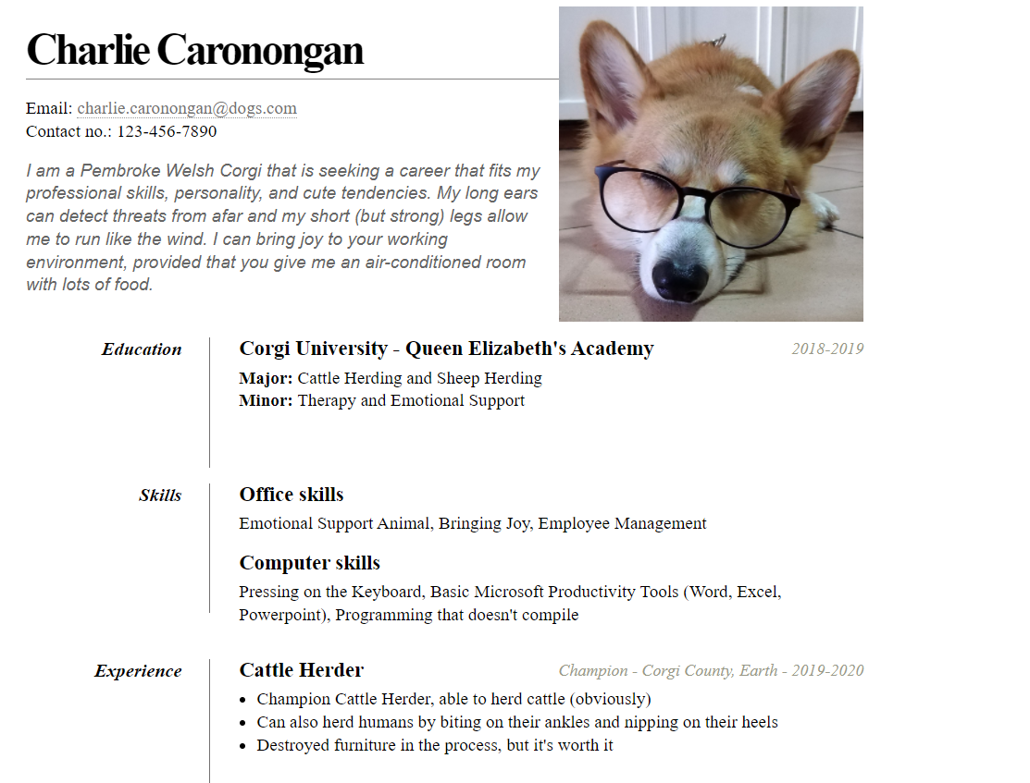

Slide 4
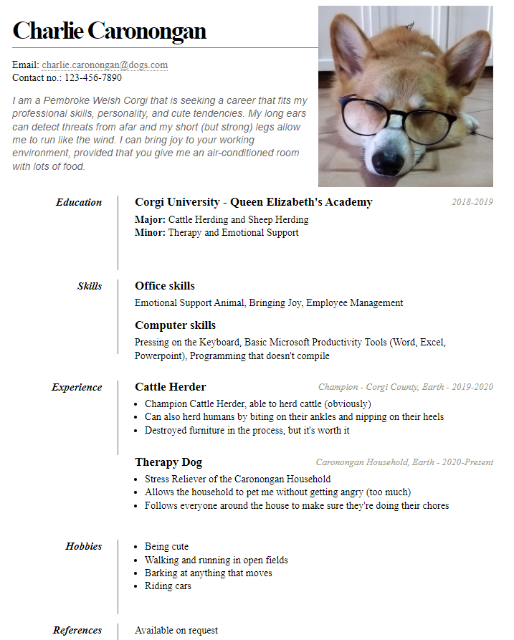

Slide 5
Global Definitions
All elements (*):
margin: 0px
padding: 0px
body:
line-height: 22px;
font: 17px Times;

Slide 6
Global Definitions
*Entire Page:
margin: 40px auto
60px;
width: 805px;
*(place all contents
In <body> inside
A <div> tag)

Slide 7

Heading Definitions
Image
height: 303px;
width: 293px;
float: right;
margin: -30px 0 0 0;

Slide 8
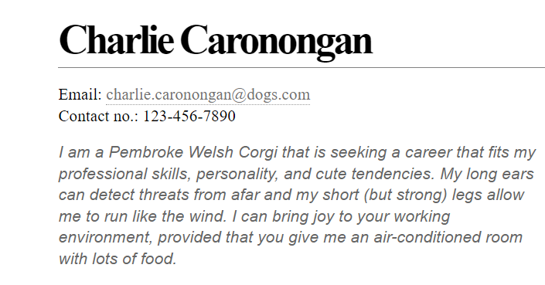
Heading Definitions
Name header
margin: 0 0 17px 0;
padding: 0 0 17px 0;
font-size: 43px;
font-weight: bold;
letter-spacing: -3px;
border-bottom: 1px solid rgb(130, 129, 129);

Slide 9
Heading Definitions
Contact info:
margin: 0 0 16px 0;
Email link:
color: rgb (115,113,113);
text-decoration: none;
border-bottom: 1px dotted #999;
Email mouse-over:
border-bottom-style: solid;
color: blue;

Slide 10
Heading Definitions
Objective:
width: 500px;
float: left;
font-family: Helvetica;
font-style: italic;
color: #666;
(NOTE: Nothing
Evil about the
color. ☺)

Slide 11
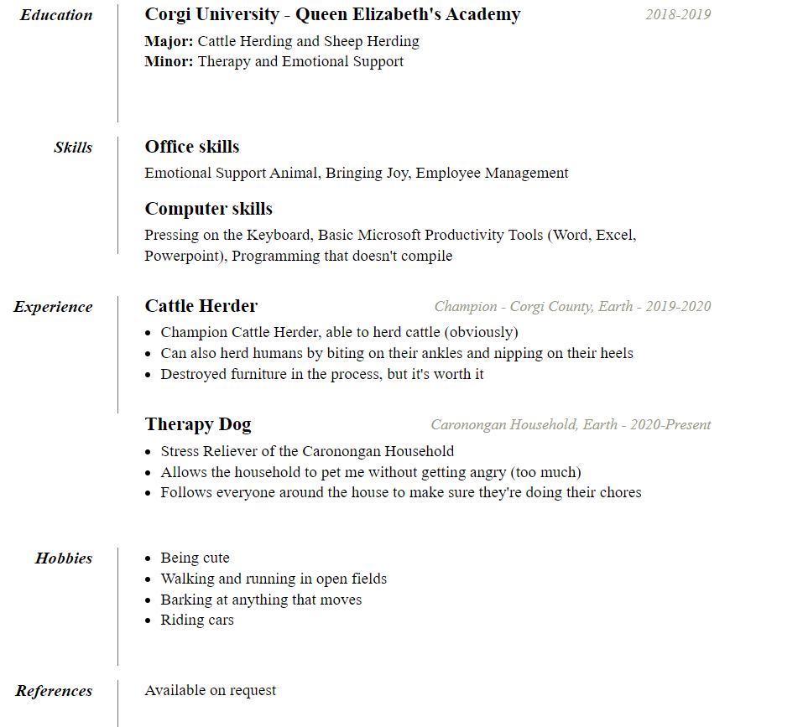
Resume Body Definitions

Slide 12
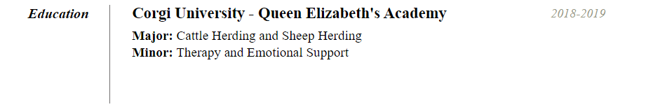
Resume Body Definition
Component:
font-style: italic;
font-weight: bold;
font-size: 18px;
text-align: right;
padding: 0 26px 0 0;
width: 150px;
float: left;
height: 100px;
border-right: 1px solid rgb (115,113,113);

Slide 13
Resume Body Definition
Description:
font-size: 20px;
margin: 0 0 6px 0;
position: relative;

Slide 14
Resume Body Definition
Date:
position: absolute;
bottom: 0;
right: 0;
font-style: italic;
font: Arial;
font-size: 16px;
color: #998;
font-weight: normal;

Slide 15
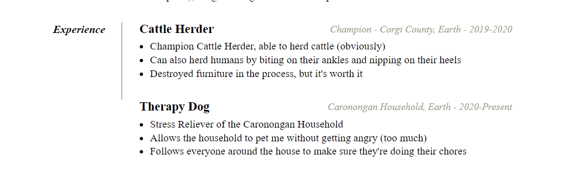
Resume Body Definition
Unordered Lists:
margin: 0 0 32px 17px;

Slide 16
Final Note
REPLACE the CONTENTS of the HTML with ACTUAL information about yourself. Imagine, you’re applying for an OJT. ☺
The Skeleton HTML is just for your reference. You need not follow it. You are free to code from scratch.

